Slide 1
ITV RFI Development
Designing within PTK v2.7 and beyond
Mark Fry
October 18, 2011

Slide 2
Background
This presentation is meant to explore existing template design options that can expand the look and feel of RFI class products.
The following designs can be made within the existing template architecture of RFI and RFI-S.

Slide 3
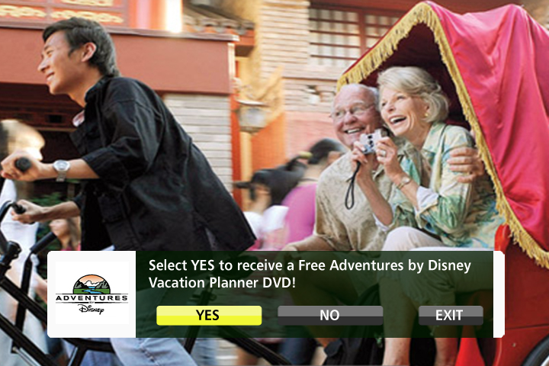
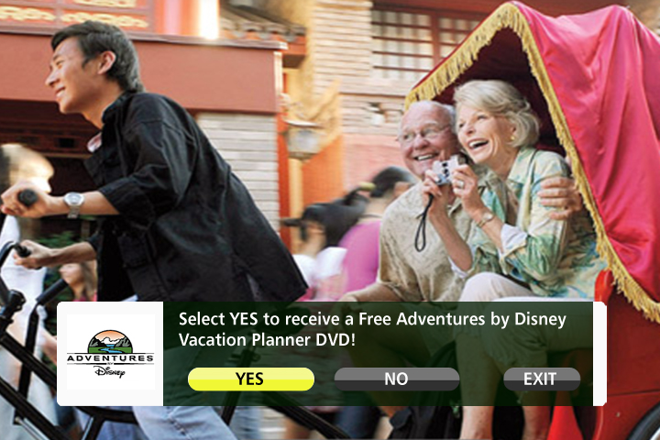
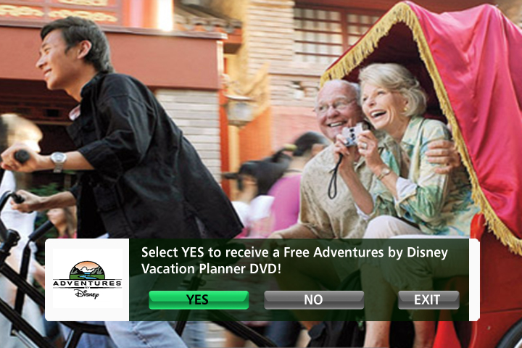
Typical RFI standard design
Adventures by Disney
Custom round shape buttons
Custom Gel Buttons
Standard Default Button set
For illustration purposes only. Text and graphics may vary slightly during Canoe’s QC process and minor variances in text alignment may occur across different set-top boxes.

Slide 4
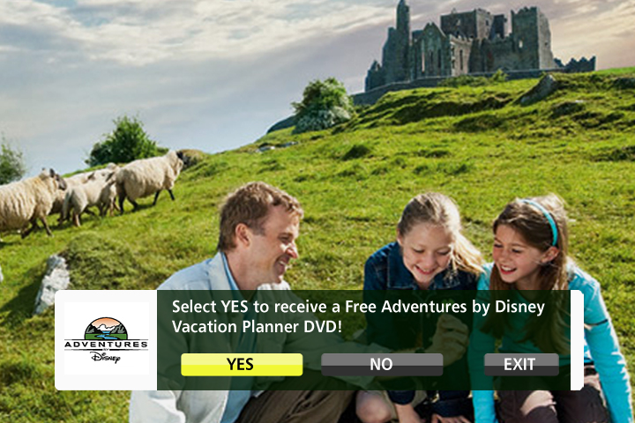
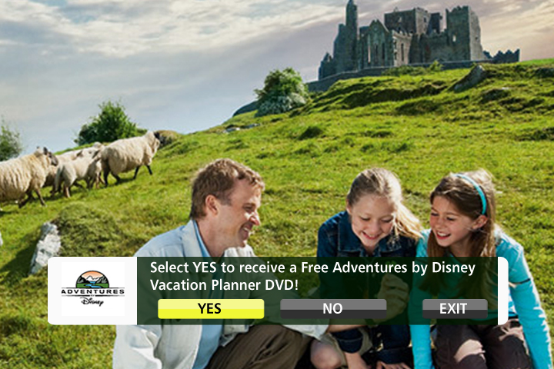
RFI shorter design
Adventures by Disney
Overlay height trimmed 20 pixels
Logo reduced 15%
For illustration purposes only. Text and graphics may vary slightly during Canoe’s QC process and minor variances in text alignment may occur across different set-top boxes.

Slide 5
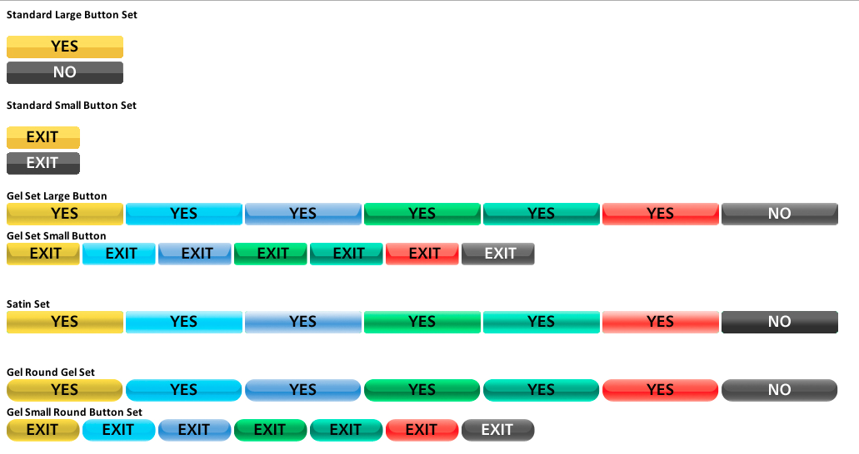
sample extended 8 bit button library
For illustration purposes only. Text and graphics may vary slightly during Canoe’s QC process and minor variances in text alignment may occur across different set-top boxes.

Slide 6



RFI-S v1.7
L’Oreal super small RFI-S
Text area and side bar merged into one shape
Shorter buttons
Logo reduced 48%
Overlay width reduced 25%
For illustration purposes only. Text and graphics may vary slightly during Canoe’s QC process and minor variances in text alignment may occur across different set-top boxes.

Slide 7
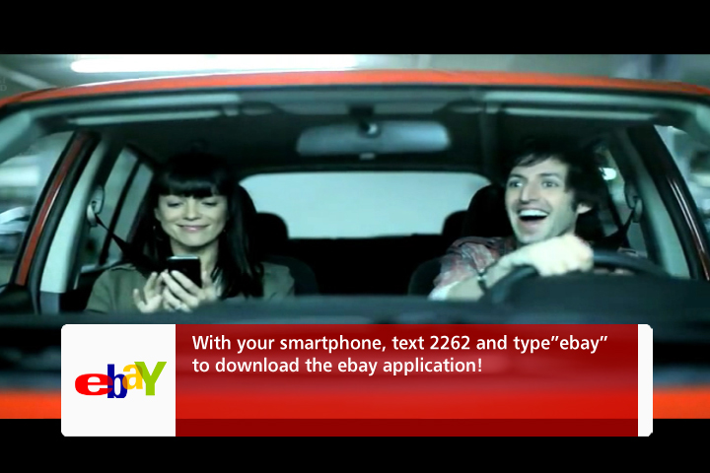
RFI options
Ebay Mobile
Info screen
Notes: disabled yes/no buttons
For illustration purposes only. Text and graphics may vary slightly during Canoe’s QC process and minor variances in text alignment may occur across different set-top boxes.

Slide 8
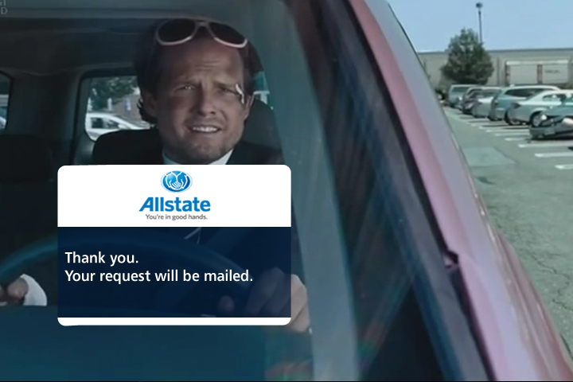
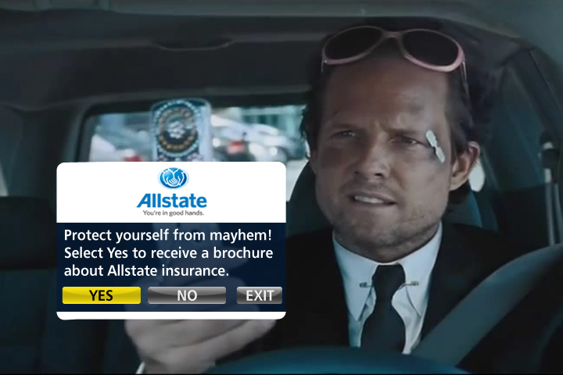
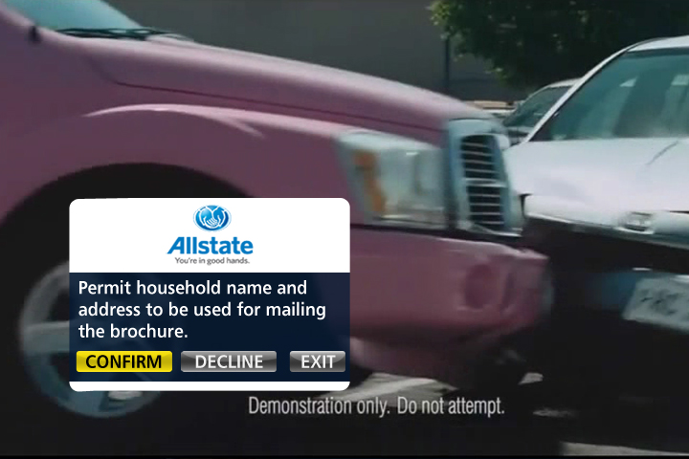
RFI v1.7 Template design modifications
Allstate Mayhem RFI panel
For illustration purposes only. Text and graphics may vary slightly during Canoe’s QC process and minor variances in text alignment may occur across different set-top boxes.

Slide 9
Atypical RFI constructs
These next examples go outside the existing RFI and RFI-S template structures.
Though they may have unique requirements, these overlays are eminently possible.

Slide 10
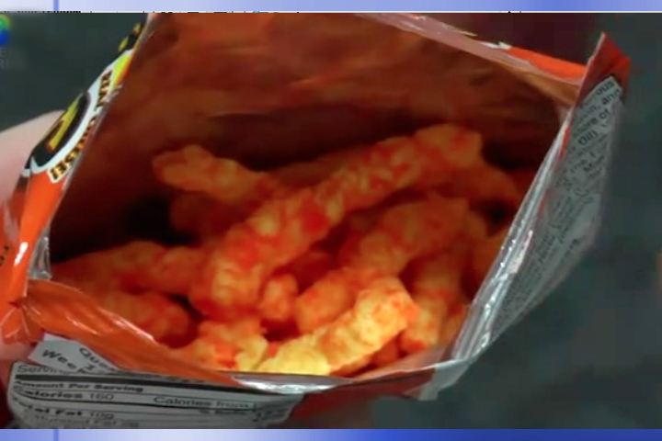
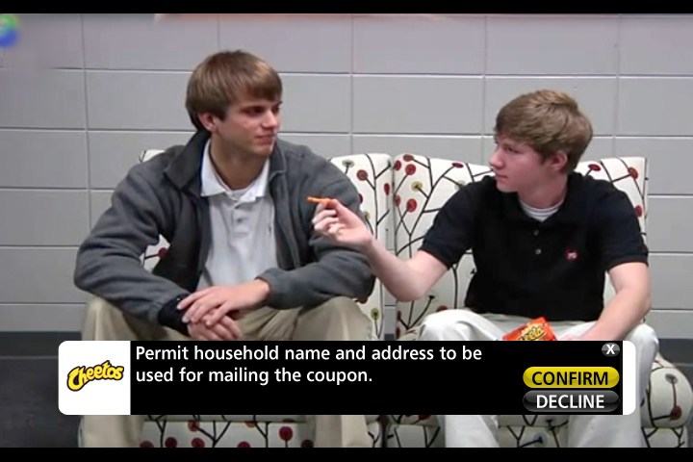
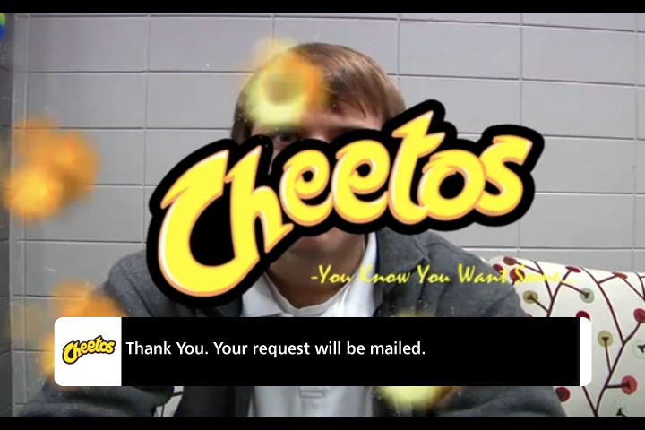
RFI v1.7 Template design modifications
Cheetos slim RFI
Close glyph button
Stacked gel buttons
For illustration purposes only. Text and graphics may vary slightly during Canoe’s QC process and minor variances in text alignment may occur across different set-top boxes.

Slide 11
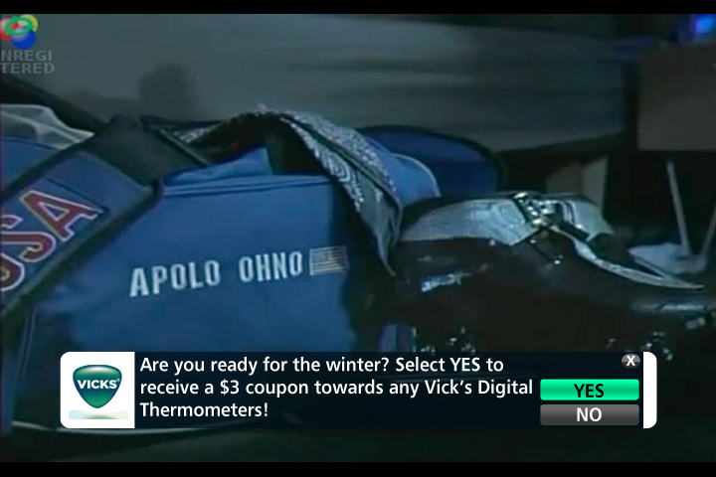
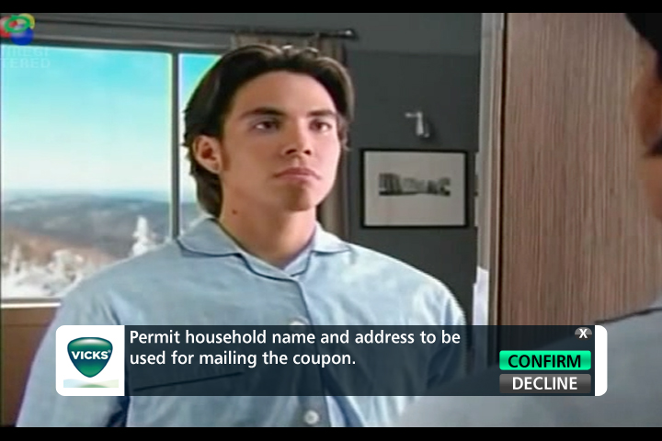
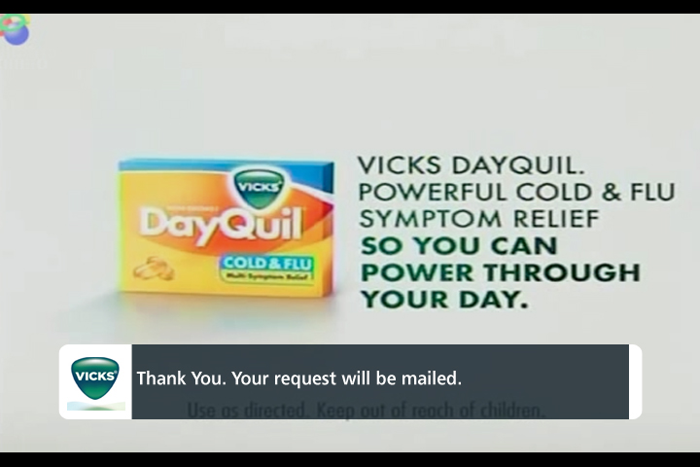
RFI v1.7 Template design modifications
Vick’s slim RFI
For illustration purposes only. Text and graphics may vary slightly during Canoe’s QC process and minor variances in text alignment may occur across different set-top boxes.

Slide 12
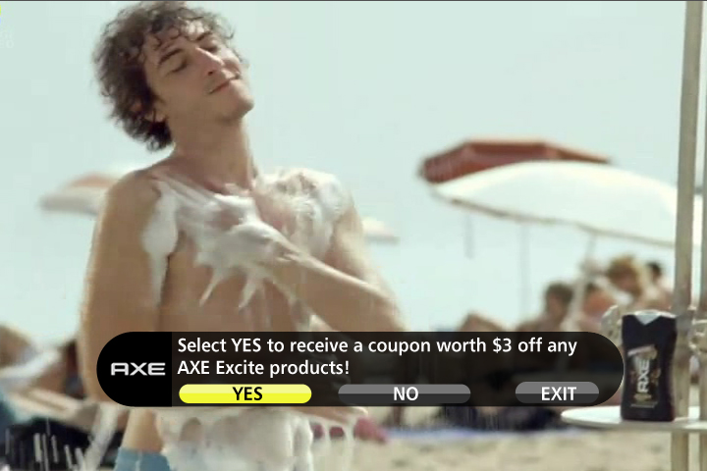
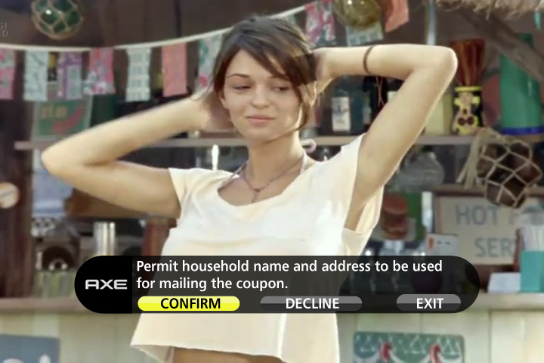
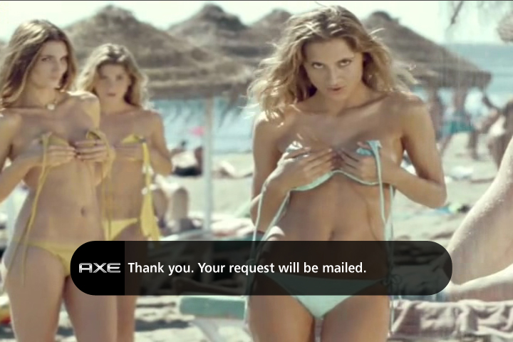
RFI v1.7 Template design modifications
AXE super slim round RFI
For illustration purposes only. Text and graphics may vary slightly during Canoe’s QC process and minor variances in text alignment may occur across different set-top boxes.

Slide 13
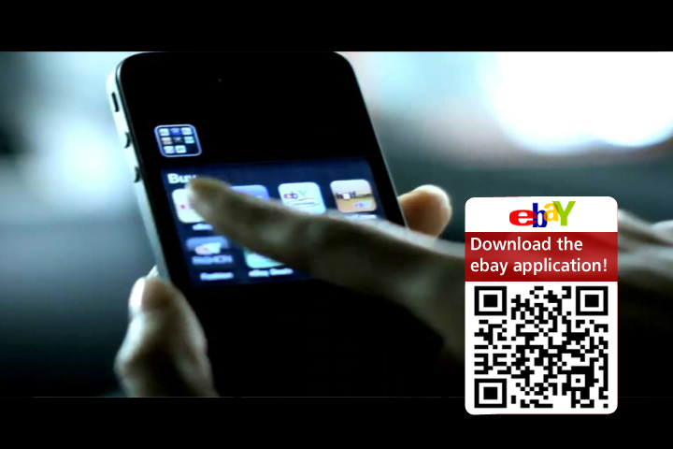
RFI design concepts
ebay Mobile
QR screen
Notes: 2 images, disabled buttons, 1 screen.
For illustration purposes only. Text and graphics may vary slightly during Canoe’s QC process and minor variances in text alignment may occur across different set-top boxes.

Slide 14
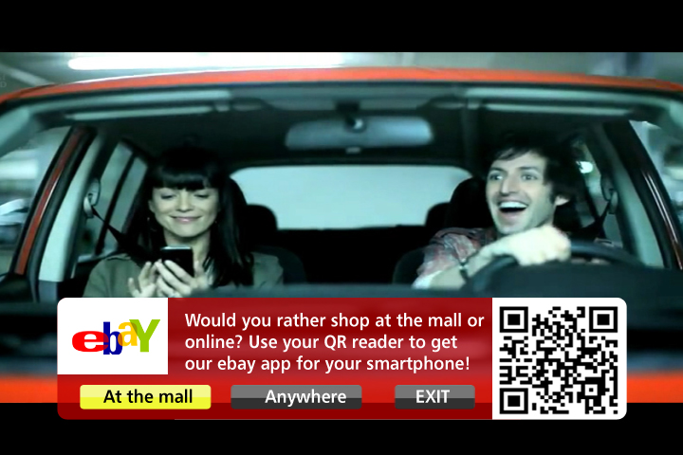
RFI-S
ebay Mobile
QR screen
Notes: Large overlay, 2 images, modified template.
For illustration purposes only. Text and graphics may vary slightly during Canoe’s QC process and minor variances in text alignment may occur across different set-top boxes.

